Slide 1

Case Study
Presented by: Shivani Awasthi

Slide 2


Table of Contents
Standardize the name column to ensure consistent title casing.
Separate combined names in the author column if there are multiple authors.
Ensure all entries in the releasedate column follow a consistent date format (DD-MM-YYYY).
Convert the time column from text format to a duration format that Excel recognizes.
Ensure the price column is in a numeric format, and identify any non-numeric values.
Convert text ratings in the stars column to numeric values.
Split the narratedby column into multiple columns if multiple narrators are listed.
Merge the releasedate and language columns into a single new column named releaseinfo with the format "DD-MM-YYYY, Language."
Ensure all currency values in the price column are formatted consistently with two decimal places.

Slide 3
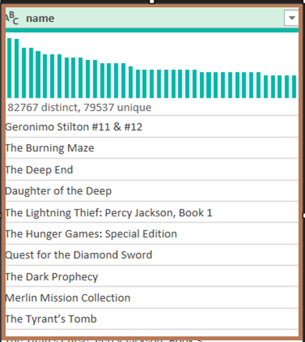
Question 1
Problem: Standardize the name column to ensure consistent title casing.
Resolution: It is already in title case. Power Query Editor has changed it.

Slide 4
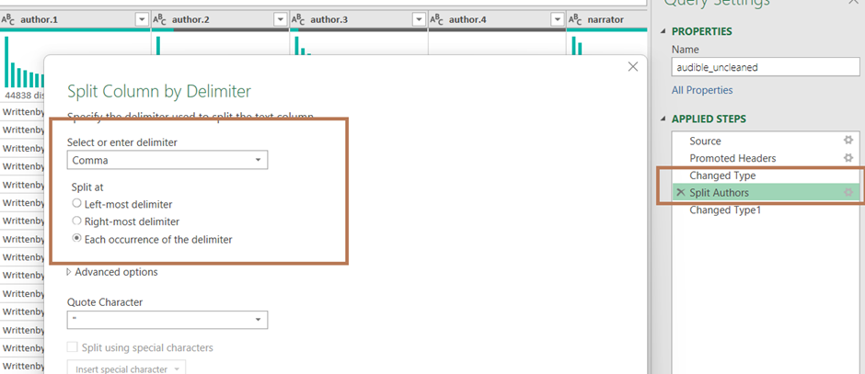
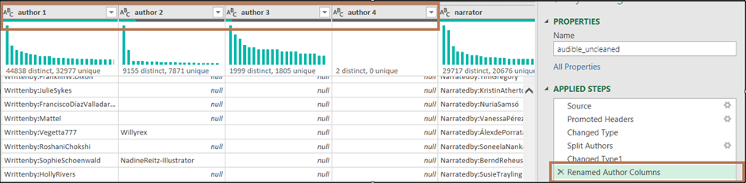
Question 2
Problem: Separate combined names in the author column if there are multiple authors.
Resolution: I have used Split by delimiter options to separate the values and then renamed the Author columns.

Slide 5
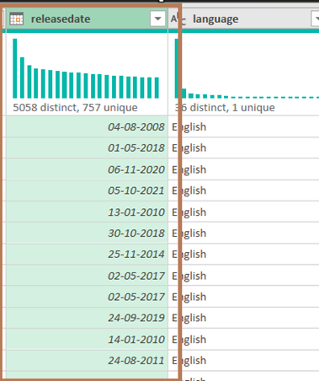
Question 3
Problem: Ensure all entries in the releasedate column follow a consistent date format (DD-MM-YYYY).
Resolution: Power Query Editor has already changed it to the required format i.e. DD-MM-YYYY.

Slide 6
Question 4
Problem: Convert the time column from text format to a duration format that Excel recognizes.
Resolution: I have added a custom column, using below M query and then changed the datatype to Duration.
M Query :
let
txt = Text.Lower([time]),
hrs = if Text.Contains(txt, "hr") then Number.FromText(Text.BeforeDelimiter(txt, "hr")) else 0,
minsPart = Text.AfterDelimiter(txt, "and "),
mins = if Text.Contains(minsPart, "min") then Number.FromText(Text.BeforeDelimiter(minsPart, "min")) else 0
in
#duration(0,hrs, mins, 0)
Continued on next page….

Slide 7
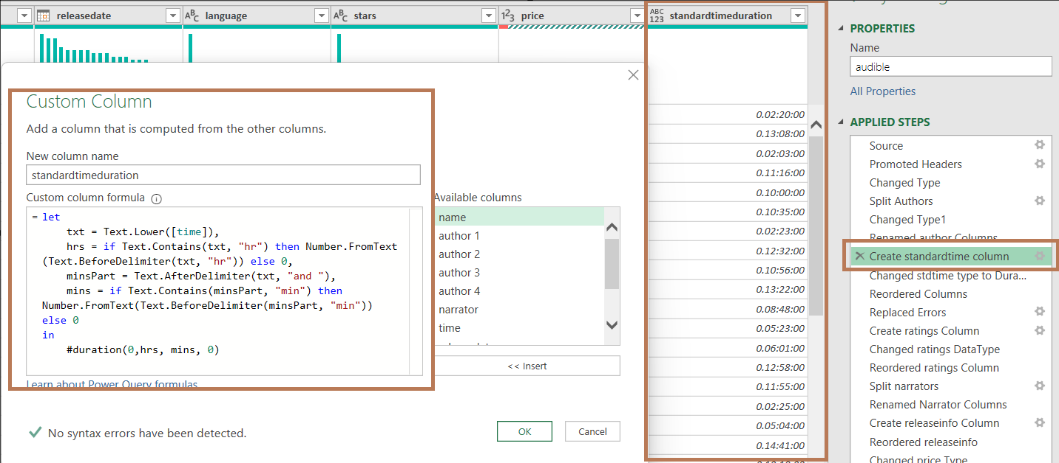
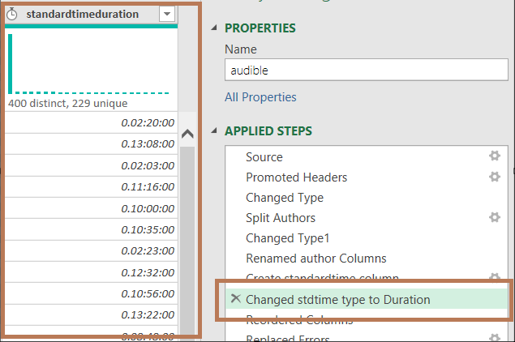
Question 4
Resolution:

Slide 8
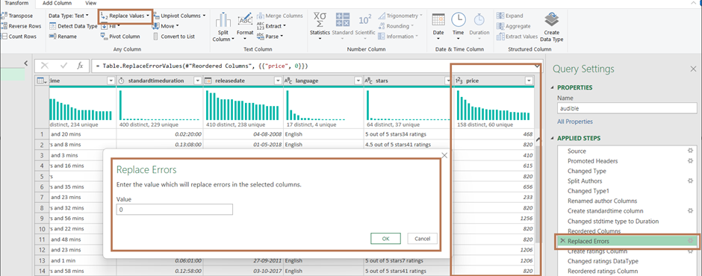
Question 5
Problem: Ensure the price column is in a numeric format, and identify any non-numeric values.
Resolution: I’ve looked into the data for Price column and found that a value “free” is present in a few places so used the option “Replace errors” to replace the value “free” with amount “0” to get all the values in numeric format.

Slide 9
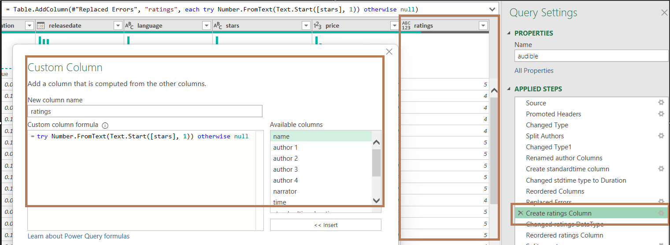
Question 6
Problem: Convert text ratings in the stars column to numeric values.
Resolution: (i). Created New Custom Column using below M query. Then change the datatype to Number in step (ii).
M Query:
try Number.FromText(Text.Start([stars], 1)) otherwise null
Continued on next page…..

Slide 10
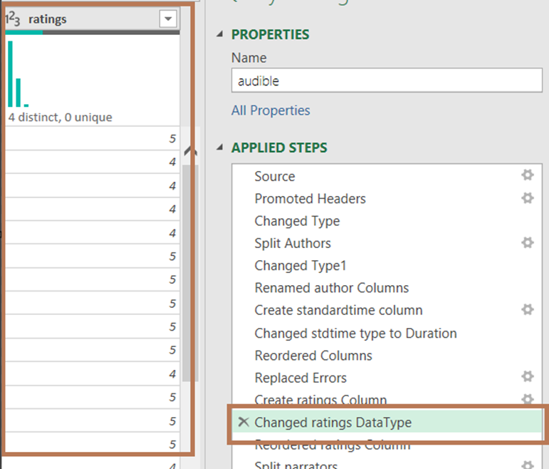
Question 6
Resolution: (ii). Changed Datatype of ratings

Slide 11
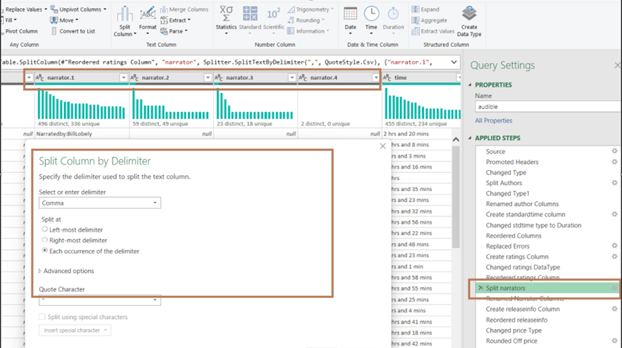
Question 7
Problem: Split the narrated by column into multiple columns if multiple narrators are listed.
Resolution: (i). Used Split by delimiter option to separate the values and then rename the headers in step (ii).
Continued on next page…..

Slide 12
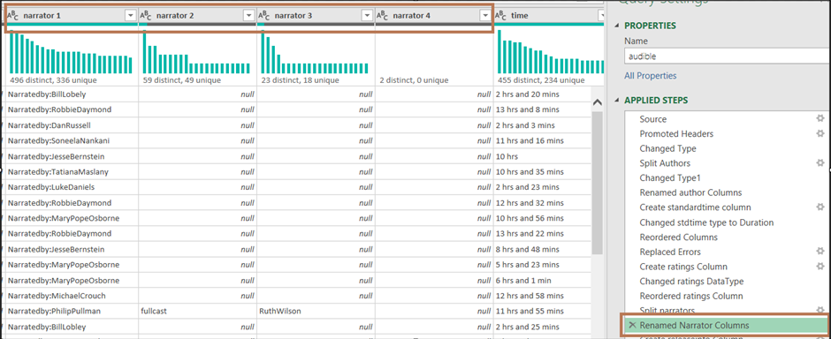
Question 7
Resolution: (ii). renamed narrator columns.

Slide 13
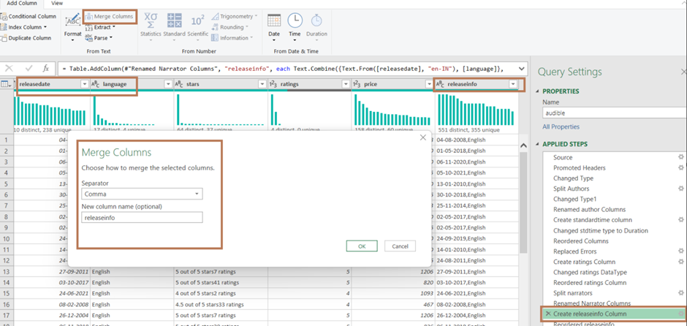
Question 8
Problem: Merge the releasedate and language columns into a single new column named releaseinfo with the format "DD-MM-YYYY, Language."
Resolution: Used Merge Columns options in Add Column tab and created a new merged column named “releaseinfo”.

Slide 14
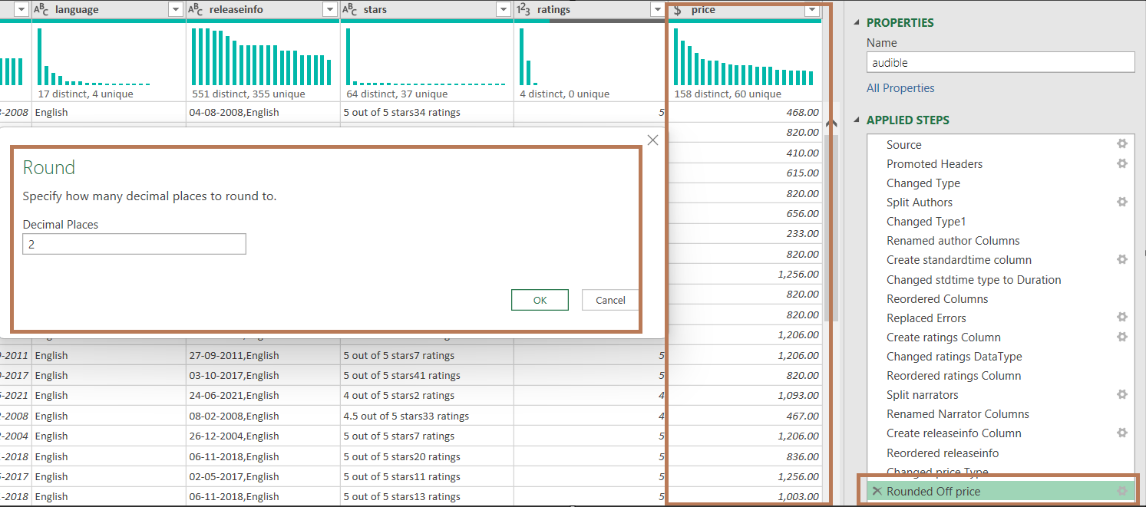
Question 9
Problem: Ensure all currency values in the price column are formatted consistently with two decimal places.
Resolution: Changed the datatype to Currency and then from Transform Tab used Round, added value as 2.

Slide 15


Presented by: Shivani Awasthi
Mentored by: Ayushi Jain

